Slide 1
Cooking Terms The language of the recipe

Slide 2
In order to be successful in the kitchen, you MUST know their meanings!

Slide 3
Why do I need to know these?
To Determine:
if it’s at your skill level
if you have required equipment
if you have enough time to
prepare
how to achieve the best results

Slide 4
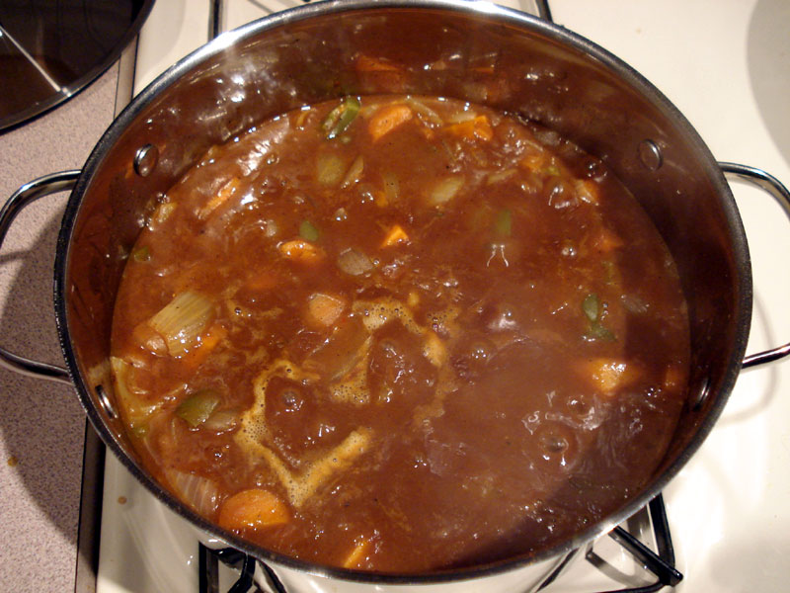
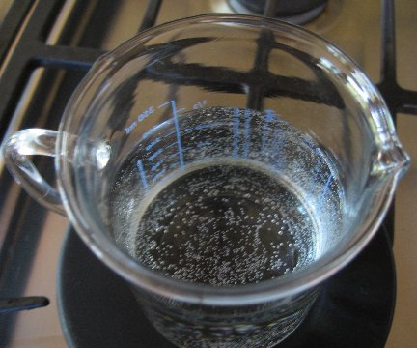
Simmer
To heat just below boiling (example: soup)

Slide 5
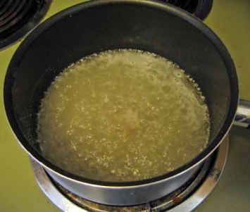
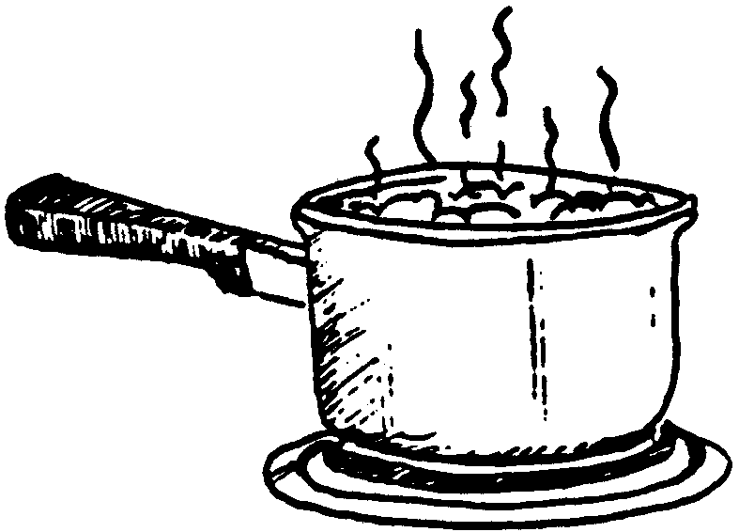
Boil
To heat until bubbles rise and break the surface

Slide 6
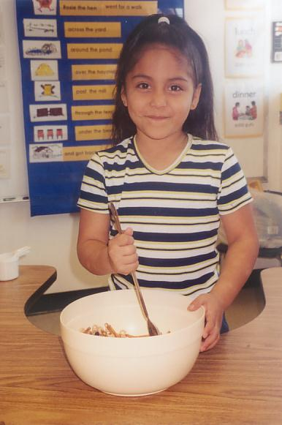
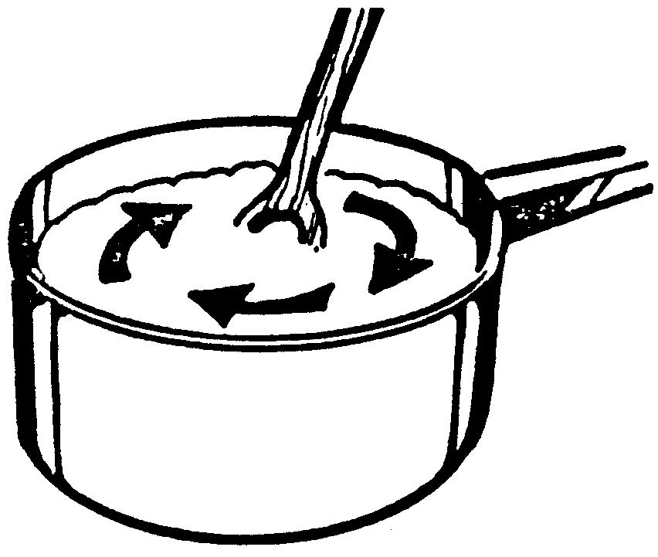
Stir
To mix in a circular
motion.

Slide 7
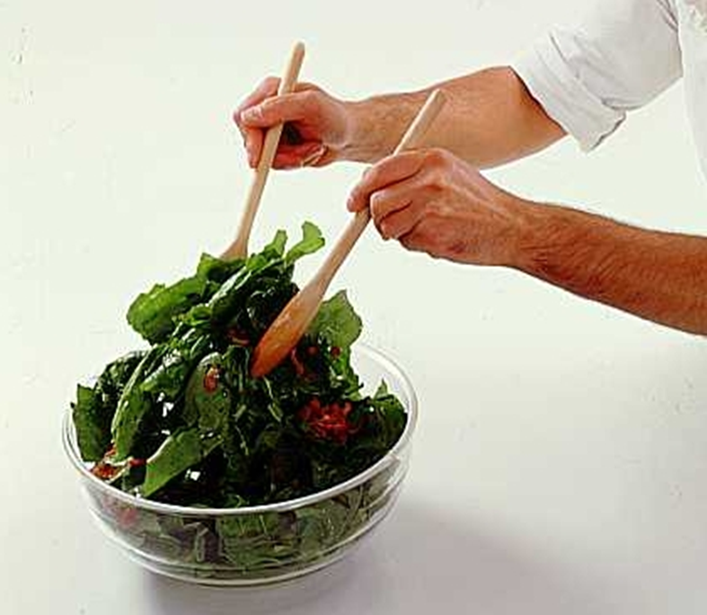
Toss
To mix foods lightly with a lifting motion

Slide 8
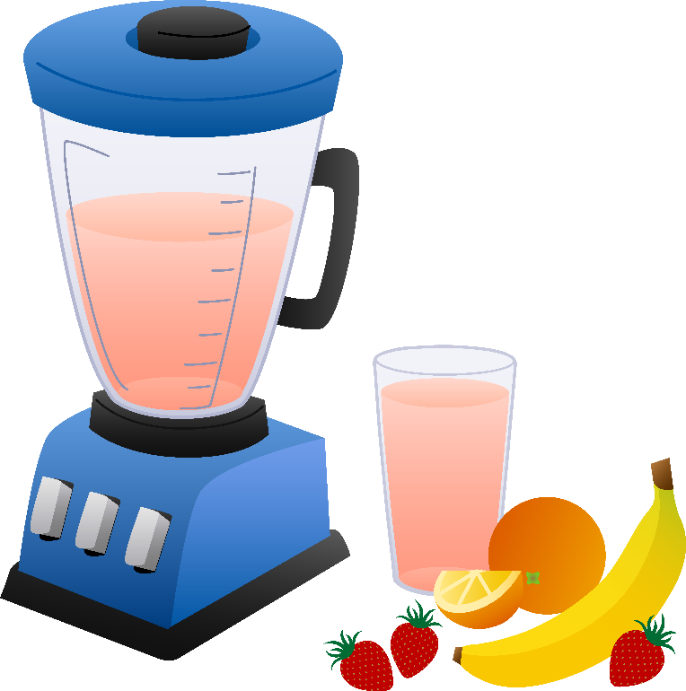
Blend
To stir two or more ingredients so they are combined

Slide 9
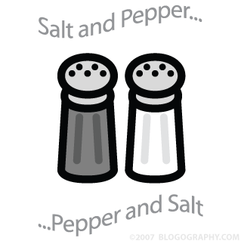
Season
To add spices to a food to add flavor

Slide 10
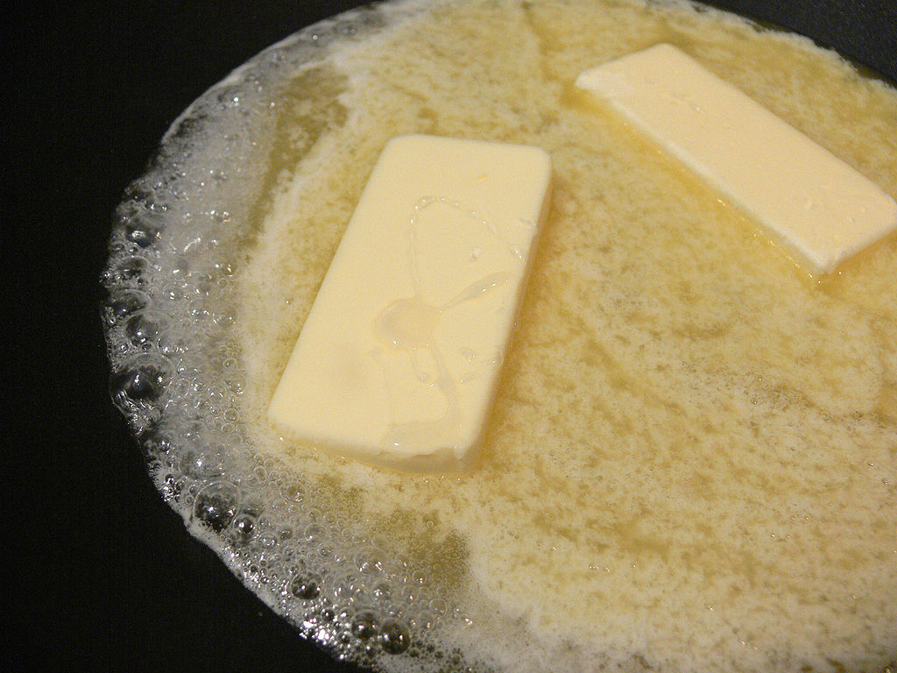
Melt
To add heat
to change a
food from a
solid to a liquid

Slide 11
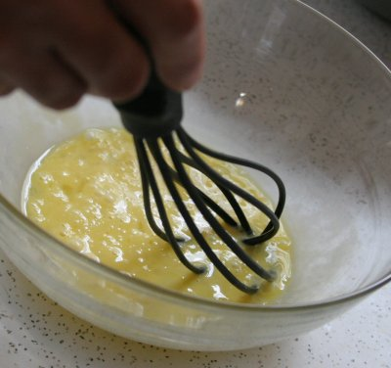
Beat
To make a mixture smooth by stirring rapidly.

Slide 12
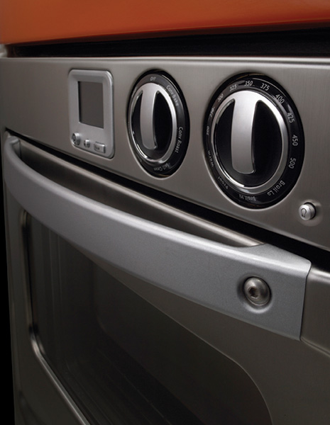
Preheat
To turn the oven heat on before baking.

Slide 13
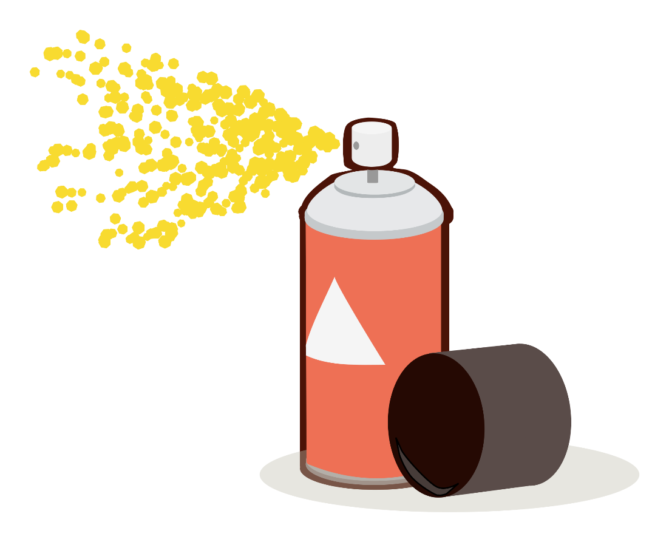
Grease
To spread or spray a thin layer of fat on baking pan
(to prevent from sticking).

Slide 14
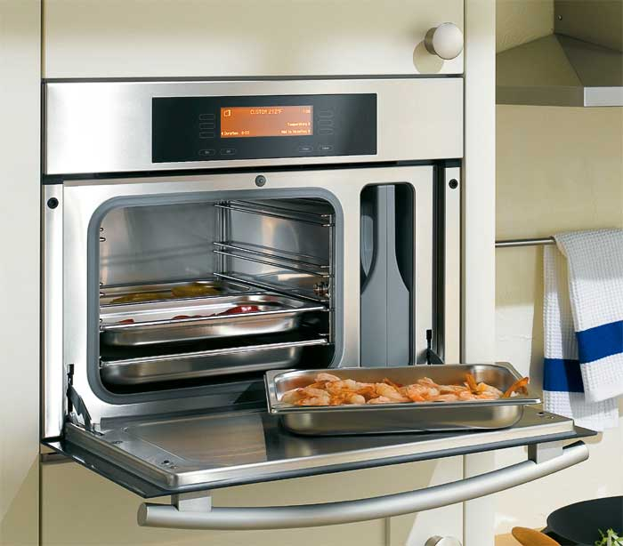
Bake
To cook in the oven with dry heat.

Slide 15
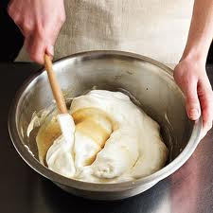
Fold
To add an ingredient into a light mixture by cutting down through the middle, across the bottom and up the side of the bowl with a rubber scraper

Slide 16
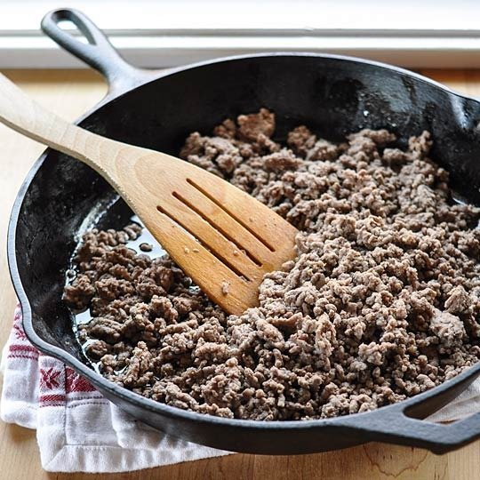
Brown
To cook in a small amount of fat over high heat to brown the surface

Slide 17
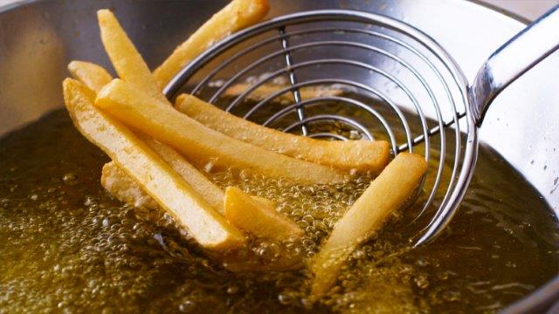
Fry
To cook in hot fat

Slide 18
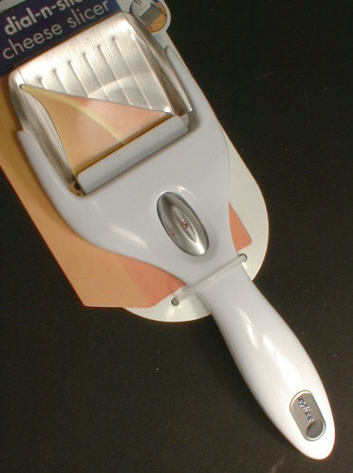
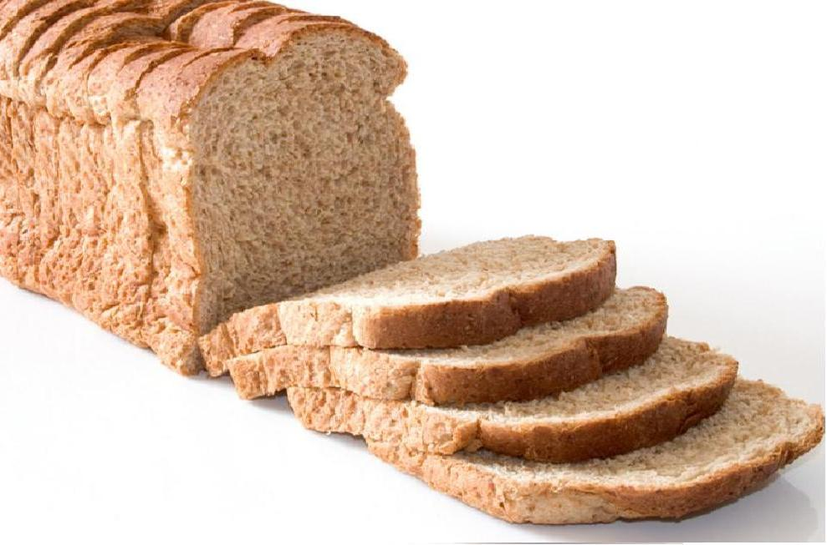
Slice
To cut into even slabs (or slices)

Slide 19
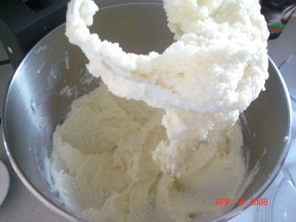
Cream
To mix butter and sugar until smooth

Slide 20
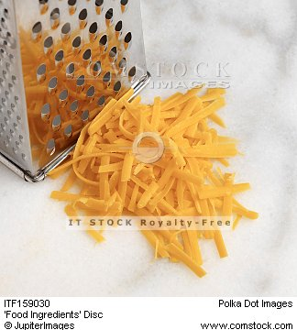
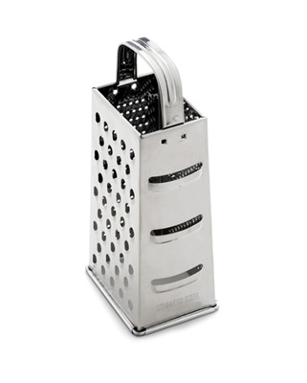
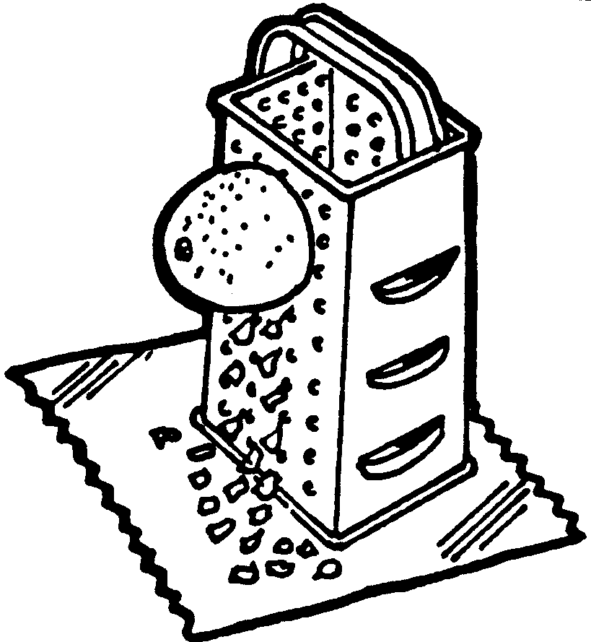
Grate
To rub on a tool that shreds or separates food into smaller pieces.

Slide 21
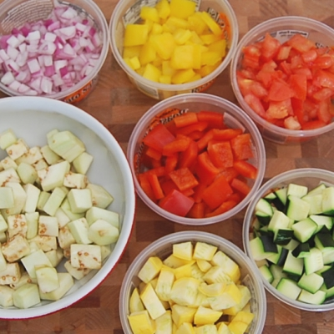
Dice
To cut into small squares (like dice)

Slide 22
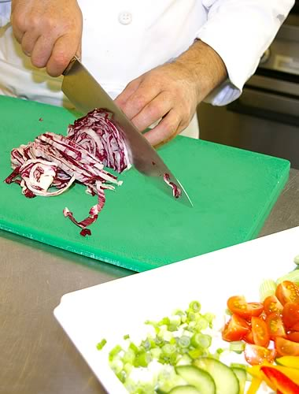
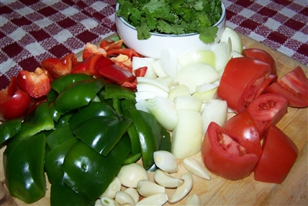
Chop
To cut into small pieces

Slide 23
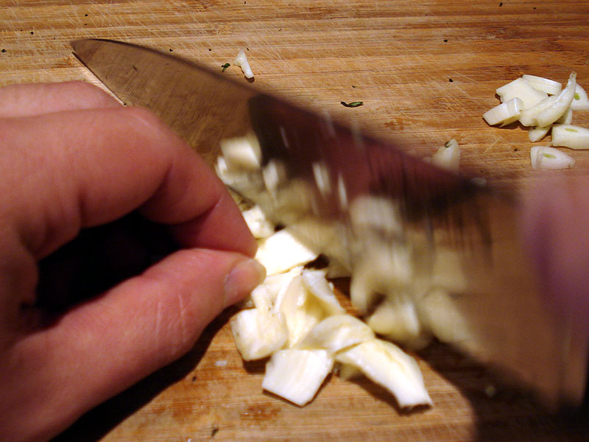
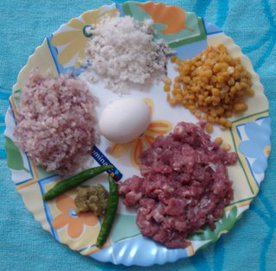
Mince
To cut into very small pieces

