Slide 1
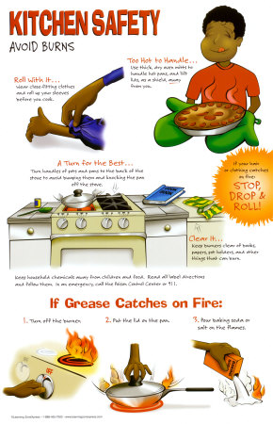
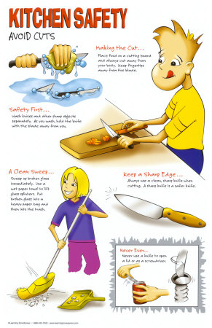
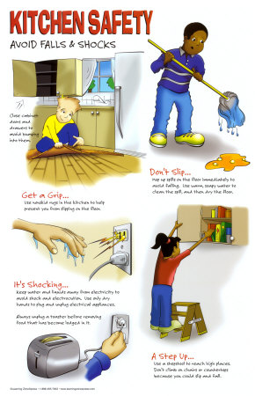
Kitchen Safety - Practices to prevent injuries in the kitchen

Slide 2
Burns
Be aware of hot surfaces
Range top, oven, pots and pans
Steam Burns – lift/open lids with opening away from your face

Slide 3
Fires
Oven Fires:
Keep door closed
Turn off heat
Range Fires:
Smother with lid, baking soda or other non-flammable cover

Slide 4
Electric Shock
Keep appliances plugged in AWAY from water sources
Do not overload outlets

Slide 5
Cuts
Always cut AWAY from yourself
More things than knives can cut you:
Peeler, grater, apple slicer, etc

Slide 6
Slips/Falls
Keep walkways clear
Wipe up spills immediately
Water, flour & cooking spray are most hazardous items

Slide 7
Range Safety (Stove Top)
Use the burner closest to you first.
Choose a burner to match the size of your pan.
Turn pan handles in
Do not allow them to hang over the edge of the counter
Use heat safe tools to stir
Open lid away from your face to avoid steam burns

Slide 8
Oven Safety
USE OVEN MITS!
Stand to the side
Open door ALL the way
Don’t reach into a hot oven – pull the rack out

Slide 9
Knife Safety
Keep knives sharp
Dull knives are more likely to cut you
Carry safely
Point down – blade back
Wash and dry immediately after use
Do NOT soak in the dishwater

